Slide 1
Cropping Systems & Sustainability
Farming methods to maximize profitability and sustainability
Notes:
By Taylor Beard & Harsimran Kaur REACCH-WSU Crop & Soils

Slide 2
Standards
The image to the left is an embedded MS Word Document. For many users you can simply double click on it to open it in a MS Word Editing window. If this does not work on your computer then right click on the image and go to “Document Object” and click “Open”
This is a “Hidden Slide.” Hidden slides will not show when the presentation is played.

Slide 3
Objectives
Define terms related to crop production, sustainability, and ecosystems
Describe traditional dry land farming techniques
Describe adaptations made to incorporate no-till into an operation
Describe a crop rotation system
Compare and contrast fallow and chemical fallow production practices
Describe the role of niche farming in your area
Select production practices that improve soil health and productivity
List production factors that augment soil nutrients
Create a production model that incorporates win-win ecological practices
Categorize farming techniques based on their environmental impact
Describe the impacts of the federal STEEP project on production practices in the Pacific Northwest
Identify specific production practices that have resulted from the research and extension efforts of Land-Grant Universities in the PNW

Slide 4
Terms
Agronomy –The branch of agricultural science dealing with the theory and practice of crop production and soil management.
Cropping System - Characterization of an agricultural field according to the crops grown, production practices, and production technologies used to grow crops.
Crop Productivity – The crop yield obtained per unit of land area (kg/ha, bu/acre)
Sustainable Agriculture – The balance of maintaining crop yields while reducing or eliminating negative impacts to the environment and supporting all people involved in food production.
Tillage –The mechanical manipulation of soil to provide better conditions for crop growth.
Agroecosystem- An approach that considers the processes and interactions occurring in a cropping system. Combines such fields as agronomy, soil and environmental science, sociology, and ecology.

Slide 5
Traditional Tillage Systems
Traditional Tillage also known as conventional tillage.
Characterized by burial and mixing of crop residue into the soil (less than 15% residue remains on surface after planting).
It involves primary, secondary and tertiary tillage.
Primary tillage – Aggressive disruption of soil using plows
Tillage tool/Equipment –Moldboard plow, Chisel plows, Disks
Secondary tillage – Less aggressive operation to smooth the soil surface for seeding.
May involve several passes of secondary equipment.
Tillage tool/Equipment – Field Cultivators, Harrows, Disks
Tertiary tillage – begins after planting and used to perform intercultural practices for weed control and crust breaking
Used mostly in organic farming to replace the use of herbicides
Tillage tool/Equipment: Hoe, Inter-row/intra-row/near-row Cultivators
Notes:
http://extension.psu.edu/agronomy-guide/cm/sec1/sec11g0
http://projects.czu.cz/EF/prednasky_2_eng.html
Book: Physical Control Methods in Plant Protection edited by Charles Vincent, Bernhard Panneton, Francis Fleurat-Lessar

Slide 6
Traditional Tillage Systems
Overall Purpose:
Improve soil conditions such as soil aeration, drainage
Control of insects/pests and weeds
Incorporation of crop residues
Drawbacks:
Accelerated runoff and soil erosion
Decline in soil organic matter
Release of CO₂ to the atmosphere
Impacting soil structure and aggregation
Soil compaction
Affect soil flora and fauna

Slide 7
Conservation Tillage Systems
Characterized by leaving most of the crop residue on the soil surface
At least 30% of residue remains on soil surface after planting
No-Tillage
Also known as zero tillage or direct seeding
Reduced Tillage
Also known as minimum tillage, mulch-tillage, or ridge-tillage
Surface residue cover after planting may range from 15% to greater than 30% depending on equipment.

Slide 8
Conservation Tillage Systems
No-Tillage
Reduced Tillage
A tillage system in which crop residue is left on the soil and the soil is left undisturbed from prior harvest.
Soil undisturbed except during seeding and nutrient injection (done at the same time).
A tillage system using the minimum number of operations required to prepare a good seed bed.
Tillage Tool/Equipment:
Chisels
Field Cultivators
Disks
Harrows
Sweeps

Slide 9
Conservation Tillage Systems
Potential Advantages
Potential Disadvantages
Reduced erosion
Improved water infiltration
Conservation of soil and water
Improved soil structure and soil health
Buildup of soil organic matter.
Reduction in fuel, labor, and machinery needs
Surface residue can delay soil warming
Impacts seed germination and early crop growth
May not be effective in poorly drained soils
Increased use of herbicides for weed control
Can increase cost
Negative impacts to environment

Slide 10
Cropping Systems are shaped by. . .
Environmental Constraints
Temperature
Rainfall
Humidity
Solar radiation
wind
Wed and Disease Pressure
Beneficial and non-beneficial insects
Pathogens
Crop Rotation and Tillage/Residue Management are tools used to achieve optimum yield under a given set of conditions.

Slide 11
Crop Rotation
The sequence of different crops grown on the same piece of land. e.g. winter wheat-spring wheat-lentils, wheat–fallow (no crop), potato-soybean-wheat
Crop Rotation Impacts:
Nutrient supply to crops (soil fertility)
Soil physical properties important to soil conservation and crop growth
Population and diversity of soil microorganisms (including plant pathogens)
Potential Advantages to Using Crop Rotation
Improved pest control (weeds and disease)
Increased soil fertility and crop performance (for example, rotating cereals with legumes)
Notes:
Reference: Kok,H., R.I. Papendick, and K.E. Saxton. 2009. STEEP: Impact of long-term conservation farming research and education in Pacific Northwest wheatlands. Journal of Soil and Water Conservation: Volume 64 (Issue 4): pages 253-264.

Slide 12
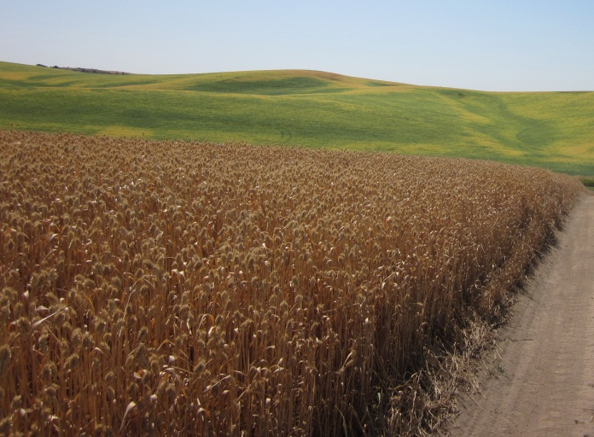
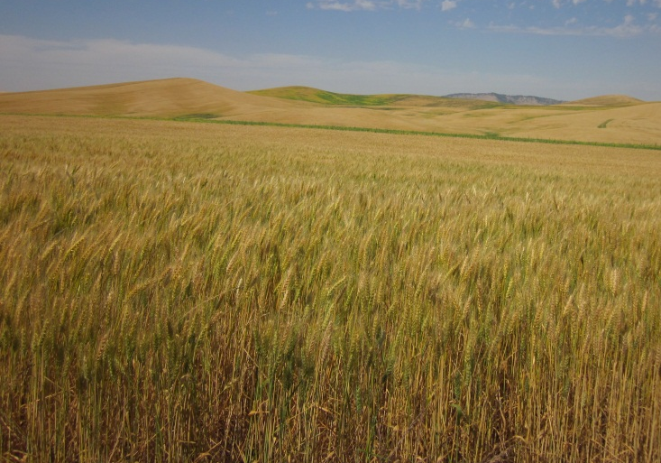
Annual Cropping Systems
Generally occurs in regions of the Pacific Northwest receiving greater than or equal to 14 inches of rain.
Example Rotations for the Palouse Region of Pacific Northwest:
Winter wheat-spring cereal-grain legume
Winter wheat-grain legume
Winter wheat
Spring wheat
Notes:
Douglas, C.L., R.W. Rickman, B.L. Klepper, J.F. Zuzel, and D.J. Wysocki. 1992 Agroclimatic Zones for Dryland Winter Wheat Producing Areas of
ldaho, Washington, and Oregon.
Winter wheat and spring wheat photos taken by Tabitha Brown. From Cook Agronomy Farm.

Slide 13
Fallow Cropping Systems
Generally occurs in regions of the Pacific Northwest receiving less than 14 inches of rain.
Main purpose of fallow period in a rotation is weed control and storage of water in soil for the subsequent crop.
The fallow period is generally 13 months long.
From wheat harvest (summer) through planting of next crop (following summer).
Types of Fallow Systems:
Mechanical Fallow (winter wheat- summer fallow)
Chemical Fallow (Spring wheat-chemical fallow)
Notes:
References:
Feng et al., 2011
Schillinger and Young, 2004

Slide 14
Fallow Cropping Systems
Mechanical Fallow
Chemical Fallow
Tillage based: requires several tillage operation to control weeds and reduce water evaporation from soil surface.
Tillage may contribute to wind and water erosion, reduced air quality, pest problems, and reduced crop yields.
Herbicide based: requires use of herbicides instead of tillage to control weeds and conserve soil moisture.
Greater herbicide use cause negative impact to the environment.

Slide 15
Connection to Soil Fertility
Managing soil fertility is critical to enhancing and sustaining productivity across all cropping systems
Chemical Fertilizers
Use of chemical fertilizers can have adverse impacts on water quality and release greenhouse gases from the soil to the atmosphere.
Practices for Building Soil Fertility*
Crop rotation (cereal-legume rotation)
Use of Cover Crops or Green Manures
for example: rye, vetch, clover, peas
Organic amendments such as farmyard manure
Residue Management (nutrient recycling and building soil organic matter)
*Farmers should include these to the extent possible. In some cropping systems one cannot simply replace chemical fertilizers and sustainably achieve yield.
Notes:
This should be part of the exercise: consider pros and cons of changing a practice versus changing and entire cropping system. It may take time to learn the new approach and for the soil/crop to respond. Would a farmer go broke before benefits are achieved. What safe guards are there to help farmers try new things to improve sustainability. These would be great things for the students to explore.

Slide 16
Farming and the environment
Farming systems have the potential to negatively impact the environment in many different ways:
Eutrophication of water bodies/aquatic systems from use of fertilizers.
May also lead to loss of aesthetic value of natural aquatic systems
Introduction of pesticides into aquatic system as well as human and animal food chain
Deterioration of soil heath from tillage and chemical inputs
Release of greenhouse gases to the atmosphere
Production and use of nitrogen fertilizers
Fossil fuel use
Addition of heavy metals to the soil such as mercury, lead etc.
Habitat loss
Deforestation –clearing more of land to grow more crops/food

Slide 17
Long-Term Sustainability
Modern practices shown to improve farming ecosystems:
Diversification in agriculture
Understanding the impact of different crops and crop management practices on environment
And how does growing different crops reduces the risk of insect/pest attack and improves farm income/profits.
Integrated nutrient management (INM)
Balanced use of inorganic chemical fertilizers and organic manures
Integrated insect/pest/weed management (IPM-INM-IWM)
Balanced use of insecticides, pesticides and herbicides in combination with intercultural practices, biological traps etc.
These approaches are important for judicious use of chemicals in agriculture.
Adoption of practices improving soil health
Adoption of practices reducing soil erosion

Slide 18
Solutions to Environmental and Economic Problems (STEEP)
STEEP began in 1975
Cooperative work of:
Farmers
Scientists
Educators
Industry
Agencies
Across three states:
Idaho
Oregon
Washington State.
Purpose of STEEP
Develop cropping systems that are profitable
Control soil erosion
Protect environmental quality
STEEP website:
http://pnwsteep.wsu.edu/index.htm
Notes:
Utilize the STEEP website to gain some background information on the STEEP project. It is credited with helping farmers alter production practices to reduce erosion and increase production.

Slide 19
The Impact of STEEP
Reduction in the soil erosion rate
Identification of economic and environmental benefits from different fertilizer application methods
Banding fertilizers below the surface versus broadcast application on the surface
Reduction in tillage through development of systems to seed and fertilize in heavy crop residue
Development of weed management for conservation tillage systems
Improved erosion control through development of disease resistance in wheat varieties
Notes:
Reference: Kok 2007

Slide 20
The Impact of STEEP cont.
Tracking adoption of conservation tillage
Identification of barriers to adoption of conservation tillage management
Development of conservation tillage systems for low precipitation areas
Reducing fallow occurrence in low rainfall areas through use of no-tillage and continuous cropping of spring crops (spring-barley-spring wheat)
Notes:
Reference: Kok 2007

Slide 21
Land Grant Institutions and Farming
Research –focusing research on the areas to better the local agriculture
University/Institution recommendations for the local agriculture
Extension – effective communication to transfer the knowledge/technology
Long-Term Agroecosystem Research (LTAR) Farms are designed to demonstrate the long-term impacts of cultivation practices and provide locations for researchers to conduct projects which span decades and have the ability to produce production data sets of over 100 years. Pullman Washington is the site of one LTAR, an extension of the original LTAR program.
Notes:
Information on the Cook Farm LTAP can be found in the readings, or at: https://www.ars.usda.gov/SP2UserFiles/Program/211/Pullman%20LTAR%20Proposal.pdf, a simplified description is located here: https://www.reacchpna.org/sites/default/files/1.3.pdf

Slide 22
Carbon Sequestration & Carbon Credits
Soil organic carbon is a major component of soil organic matter
Soil organic carbon is lost following the conversion of native lands to agricultural production.
The carbon lost from the soil is emitted to the atmosphere as carbon dioxide (CO₂) which is an important greenhouse gas
Farmers can receive ‘Carbon Credits’ for adopting practices that rebuild soil organic C levels to native values.
Termed carbon sequestration
The carbon credits represent a payment for removal of C from the atmosphere that is stored in the soil organic matter.
Reduces rising levels of CO₂ in the atmosphere
Builds soil organic matter
Notes:
From Carbon Report by T. Brown and D. Huggins

Slide 23
Carbon Sequestration & Carbon Credits
Adoption of the following agricultural practices have been shown to partially restore depleted soil organic carbon (sequester C in the soil):
1. Adopt conservation tillage or no-tillage;
2. Eliminate fallow
3. Increase use of cover crops, including use of perennial crops in the rotation
4. Increasing residues returned to the soil
5. Applying soil amendments (manures for example)
6. Using fertilizers
7. Selection of high yielding crop varieties

Slide 24
Activity 1:
Utilize the regional crop cards (included in the zipped reading file) and the US commodity maps for the same crops to explore what types of crops are cultivated in the Pacific Northwest.
Using the included crop production report, or a more recent one, assign students to groups to give presentations on the crops, their uses, and relative production levels across the country.
Extension: Locate production reports from one and two decades ago to create a table using Excel to document changes on the county and state level.

Slide 25
Activity 2:
Read several of the Farm Studies
http://pnwsteep.wsu.edu/dscases/index.htm
Analyze the farming system for win-win practices like:
Optimized production & cash flow
Optimized carbon sequestration
Reduced environmental degradation while improving soil health and obtaining optimum yield/economic return
Notes:
Class discussion or a short report could be used to help the students dig into the case-studies. Students could also be assigned one practice and could analyze how each farmer in 3 different case studies was able to utilize their specific cultivation practice to maximize sustainability, what challenges had to be addressed, and other variables.

